Slide 1
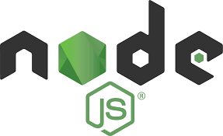
Node.js Overview: What is Node.js
Node.js® is an open source JavaScript Runtime Environment built on Chrome’s V8 JavaScript engine.
Node.js is:
Single-threaded
Event-driven,
Based on a non-blocking I/O model.

Slide 2
Node.js Overview: JS Engine and JS Runtime Environment
JavaScript Engine
The JavaScript engine translates your script into runnable machine code instructions so it can be executed by the CPU of the host machine. The engine translates scripts at runtime on the fly. Your code won’t be compiled unless you run it
JavaScript Runtime Environment
The JavaScript runtime environment provides your scripts with utility libraries which can be used during execution. It’s your script that references these libraries. The engine itself doesn’t depend on them.

Slide 3
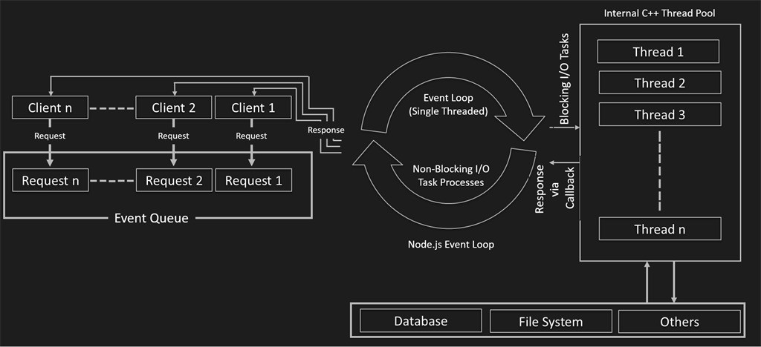
Node.js Overview: Event-Driven, Single-Threaded, Non-Blocking I/O

Slide 4
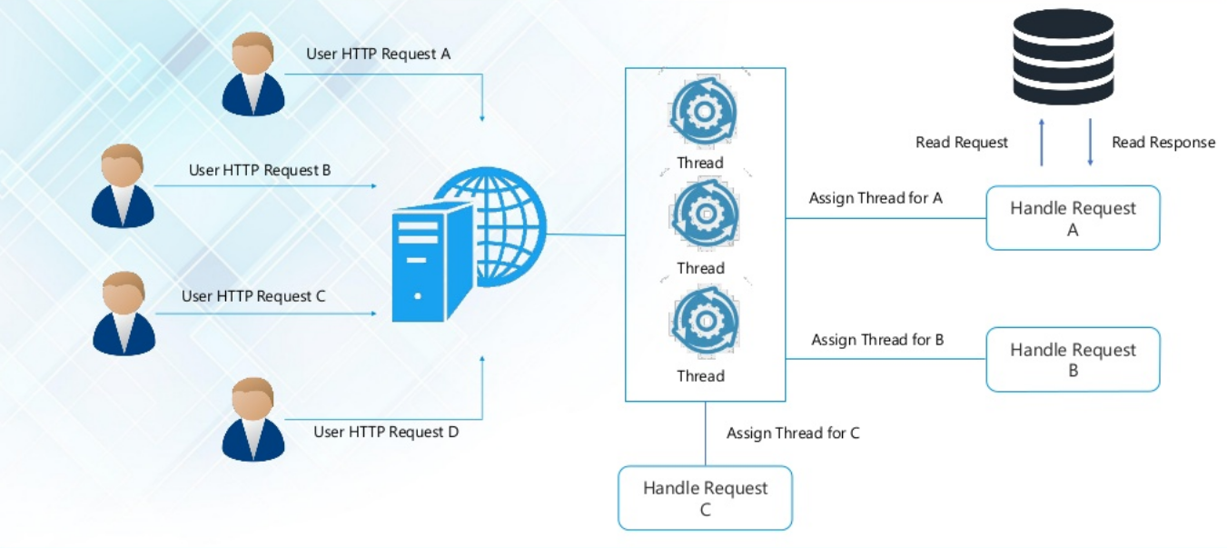
Node.js Overview: Single-Threaded vs Multi-Threaded

Slide 5
Node.js Overview: Single-Threaded vs Multi-Threaded
Main Challenges in Multi-threaded Systems
Deadlock
Scalability
Scalability
What is you still needed to use Multi-threading in Node?
JavaScript also supports multi-threading through the child_process.fork() API

Slide 6
Node.js Overview: Node.js vs JS in the browser
Web Browser
Node.js
Web Sockets
DOM
XHR
Process
File System
Net
File Reader
JavaScript
V8
Audio
HTTP
JavaScript
V8
Cluster
Timers
Video
Many More…
Timer
Stream
Many More…

Slide 7
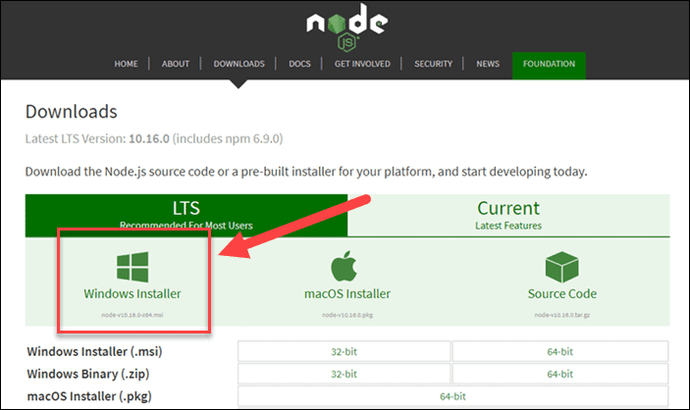
Node.js Overview: Installing Node.js
Step 1: Download Node.js Installer
In a web browser, navigate to https://nodejs.org/en/download/. Click the Windows Installer button to download the latest default version. At the time this article was written, version 10.16.0-x64 was the latest version. The Node.js installer includes the NPM package manager.

Slide 8
Node.js Overview: Installing Node.js and NPM
Step 2: Install Node.js and NPM from Browser
Once the installer finishes downloading, launch it. Open the downloads link in your browser and click the file. Or, browse to the location where you have saved the file and double-click it to launch.
2. The system will ask if you want to run the software – click Run.
3. You will be welcomed to the Node.js Setup Wizard – click Next.
4. On the next screen, review the license agreement. Click Next if you agree to the terms and install the software.
5. The installer will prompt you for the installation location. Leave the default location, unless you have a specific need to install it somewhere else – then click Next.
6. The wizard will let you select components to include or remove from the installation. Again, unless you have a specific need, accept the defaults by clicking Next.
7. Finally, click the Install button to run the installer. When it finishes, click Finish.

Slide 9
Node.js Overview: Installing Node.js
Step 3: Verify Installation
Open a command prompt (or PowerShell), and enter the following:
node –v
The system should display the Node.js version installed on your system. You can do the same for NPM:
npm –v

Slide 10
Demo: Installing Node.js and NPM

Slide 11
Node.js Overview: Node.js Programs
The node command
When Node.js is installed on a system, it provides a program called node, which is used to run JavaScript files. Say you have a file hello.js, containing this code:
var message = "Hello world";
console.log(message);
You can then run node from the command line like this to execute the program:
node hello.js
The console object
The console.log method in Node does something similar to what it does in the browser. It prints out a piece of text. But in Node, the text will go to the process’ standard output stream, rather than to a browser’s JavaScript console.
global & process VS. window & document
global is top-level object similar to window on browser. process is object inside global : global.process. For more information: https://nodejs.org/api/globals.html#globals_global
NOTE: Browser-related functionality, such as document and alert, is absent!

Slide 12
Demo: Hello Node

Slide 13

Node.js Overview: Node Package Manager (NPM)
The NPM utility is bundled together with your Node installation.
NPM provides a public package repository, a specification for building packages, and a command line tool for working with packages
The company npm, Inc. develops and maintains NPM
Node.js distributes the npm executable along with the node executable, but it's actually a separate program with its own versioning

Slide 14
Node.js Overview: Node Package Manager (NPM)
Global vs Local NPM Packages
Packages can be installed locally or globally
Local packages are stored locally in a project, in the node_modules folder
Global packages are stored globally on system
Typically, local packages are code libraries used by project
Typically, global packages are executables used to perform some operation on a project such as running tasks
Local packages are available only within their specific project, and global packages are available system wide

Slide 15
Node.js Overview: Node Package Manager (NPM)
Installing and Uninstalling Packages
The npm program is used to manage packages
The first argument to the npm program is the command to be executed
Packages can be installed with the install command, and uninstalled with the uninstall command
There are many more commands available for NPM
The –global flag installs and uninstalls the package globally, without the global flag, the packages are installed and uninstalled locally

Slide 16
Demo: Initialising a project using NPM (npm init)

Slide 17
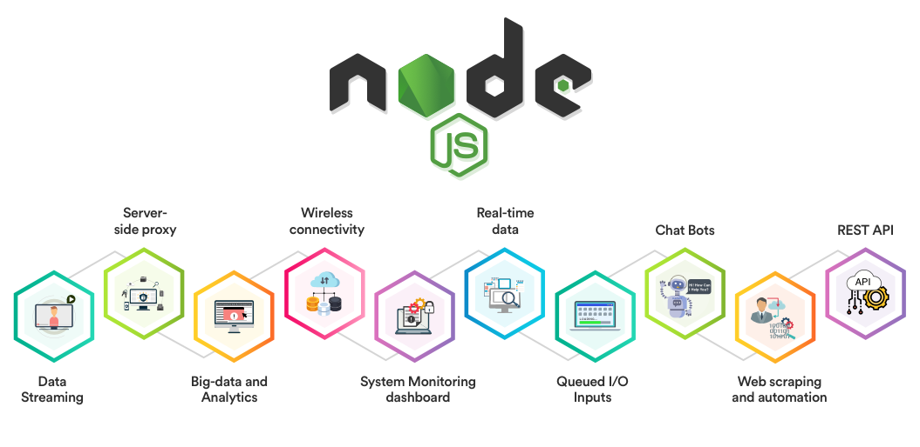
Node.js: Types of Node Apps

Slide 18
Node.js Overview: Conclusion
You should now be able to install both the Node.js framework, and the NPM package manager. You’ve also written your first node.js JavaScript program!
The NPM framework gives access to many different JavaScript solutions, which can be found at npmjs.com.

Slide 19
Exercise: Install Node and write a Hello World Program

